Slide 1
Welcome!
This is your customizable presentation that you can use to share Salesforce Lightning with your company, gain executive buy-in, and educate stakeholders on the value of moving to the Lightning Experience interface. Feel free to make changes to support your business and use cases.
If you’re an existing customer, you can also use this to decide when to start transitioning all or part of your team to Lightning Experience.
Notes:
The next few slides give you some handy hints about how to use this deck template.
Remember to delete or skip these introductory slides before you present, as they’re for your reference only.

Slide 2
What’s Included in this Kit?
A PowerPoint Presentation
Includes speaker notes to help prepare you to deliver presentations.
2 Easy-to-Follow Demos
Includes demo instructions, click-paths & videos to help prepare you to demo Lightning Experience
1
2
Notes:
This template helps address these points:
What is Salesforce Lightning and why is it so important.
What can my users do with Lightning Experience.
What can admins do with Lightning Experience and Lightning Platform?

Slide 3

Salesforce Lightning
Meet the New Salesforce!
Your Name
Title

Slide 4


Forward-Looking Statement
Statement under the Private Securities Litigation Reform Act of 1995
This presentation may contain forward-looking statements that involve risks, uncertainties, and assumptions. If any such uncertainties materialize or if any of the assumptions proves incorrect, the results of salesforce.com, inc. could differ materially from the results expressed or implied by the forward-looking statements we make. All statements other than statements of historical fact could be deemed forward-looking, including any projections of product or service availability, subscriber growth, earnings, revenues, or other financial items and any statements regarding strategies or plans of management for future operations, statements of belief, any statements concerning new, planned, or upgraded services or technology developments and customer contracts or use of our services.
The risks and uncertainties referred to above include – but are not limited to – risks associated with developing and delivering new functionality for our service, new products and services, our new business model, our past operating losses, possible fluctuations in our operating results and rate of growth, interruptions or delays in our Web hosting, breach of our security measures, the outcome of any litigation, risks associated with completed and any possible mergers and acquisitions, the immature market in which we operate, our relatively limited operating history, our ability to expand, retain, and motivate our employees and manage our growth, new releases of our service and successful customer deployment, our limited history reselling non-salesforce.com products, and utilization and selling to larger enterprise customers. Further information on potential factors that could affect the financial results of salesforce.com, inc. is included in our annual report on Form 10-K for the most recent fiscal year and in our quarterly report on Form 10-Q for the most recent fiscal quarter. These documents and others containing important disclosures are available on the SEC Filings section of the Investor Information section of our Web site.
Any unreleased services or features referenced in this or other presentations, press releases or public statements are not currently available and may not be delivered on time or at all. Customers who purchase our services should make the purchase decisions based upon features that are currently available. Salesforce.com, inc. assumes no obligation and does not intend to update these forward-looking statements.
Notes:
Key Message Salesforce is a publicly traded company. Customers should make buying decisions only on the products commercially available.
Talk Track Just a quick note to base purchasing decisions on products and services that are currently available.

Slide 5

Agenda
1
Introduction to Salesforce Lightning
10 Lightning Experience Features to Increase Productivity
Demo 1: Productivity Features
5 Ways to Customize Lightning Experience
Demo 2: Customization Features
Lightning Resources & Discussion
2
3
4
5
6
Notes:
This is an outline of the topics of discussion.
Start by telling your audience a little bit about Salesforce Lightning and then dive into some demos that show the cool new Lightning Experience features in action!

Slide 6
What is Salesforce Lightning?

Slide 7


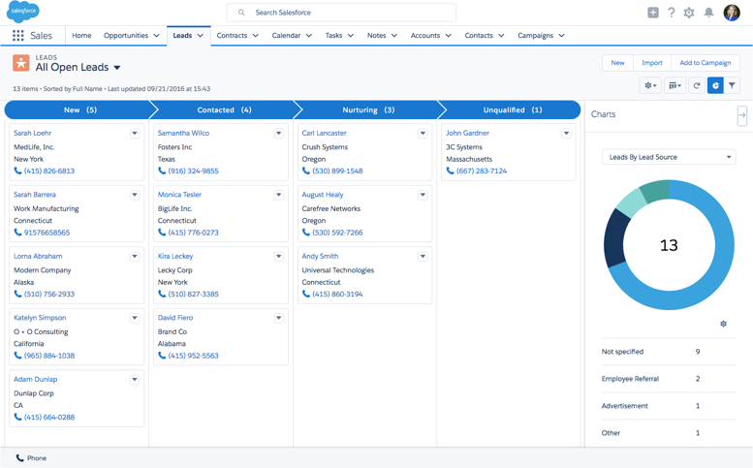
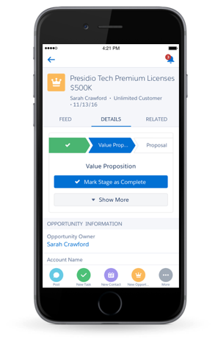
Lightning is the New Salesforce
Your path to productivity and customization
Efficiency-Driven Workspaces
Find, prioritize and act with workflow built in
Productivity-Oriented Design
Make calls, take notes, log tasks and send emails where you work
Quickly Customize and Build
Extend Salesforce with Lightning App Builder, and apps and components from the AppExchange
Smarter with Einstein
Your personal data scientist, helping you prioritize your day and focus on the right customers
Notes:
Salesforce Lightning is the future of Salesforce. It’s where you get all new Salesforce innovation.
Gain a competitive advantage with Lightning. Teams spend more time providing exceptional customer experiences and less time juggling technology and applications.
Find, prioritize, and act on important work
Make calls, take notes, log tasks, and send emails from a single page
Work smarter with a built-in data scientist
Deliver personalized service, faster
Admins win too. The flexibility of Lightning allows admins to easily customize the interface, so your users can work the way they want.

Slide 8




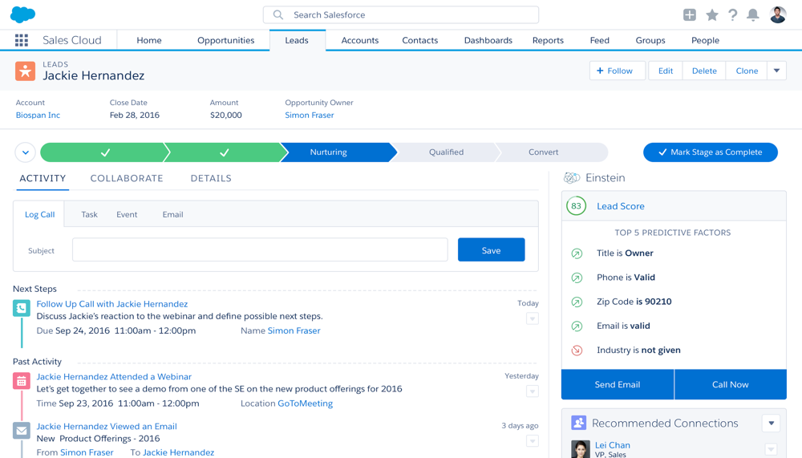

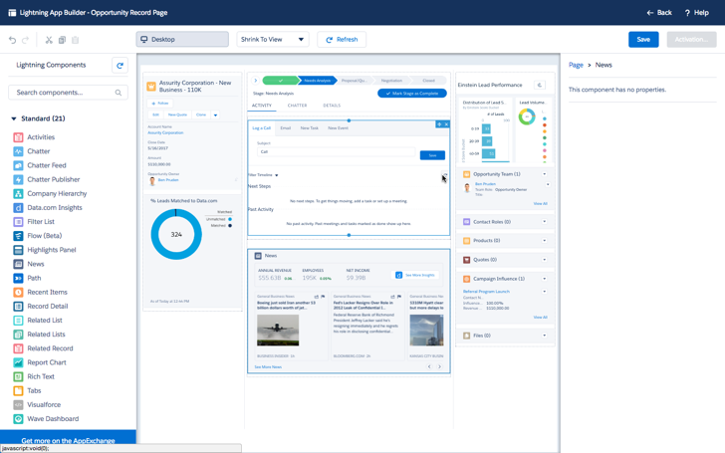



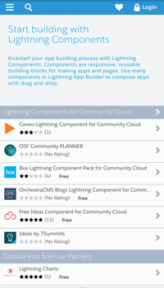
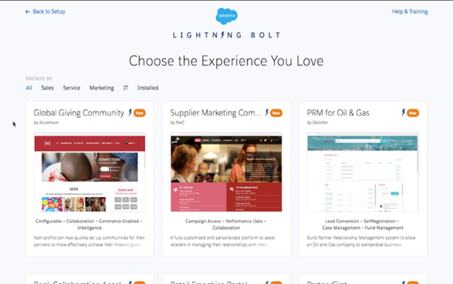
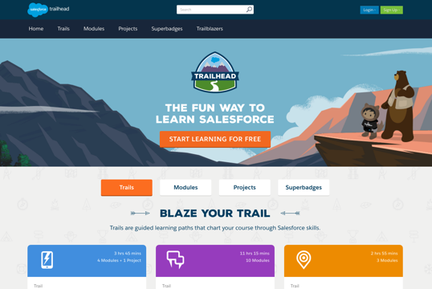





Salesforce is Better with Lightning
Experience
Be more productive in every moment
Platform
Aligned tools for customers, partners, and Salesforce
Ecosystem
Lightning-ready apps and components on the AppExchange
Check out Lightning in Trailhead
Notes:
Lightning includes:
An experience, so every Salesforce user can be more productive in every moment.
A platform for an aligned set of tools for customers, partners, and Salesforce.
An ecosystem of Lightning-ready apps and components on the Salesforce AppExchange.
Lightning makes everyone more productive—end users, admins, and developers.

Slide 9

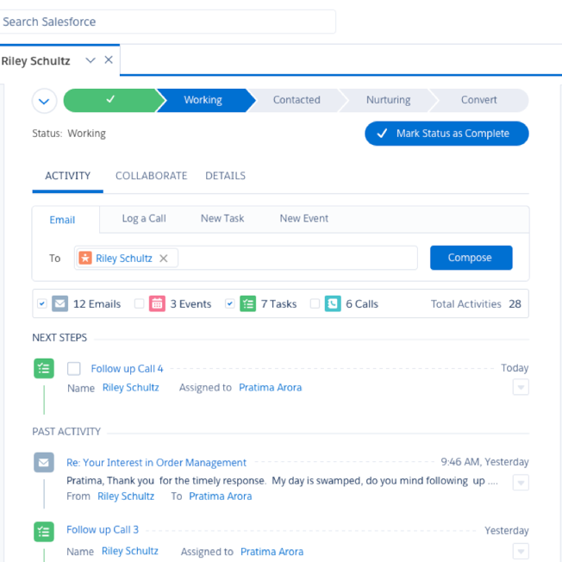
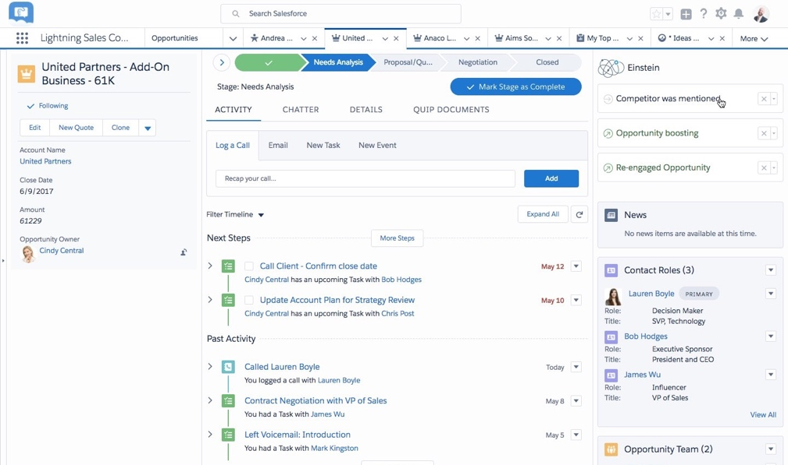

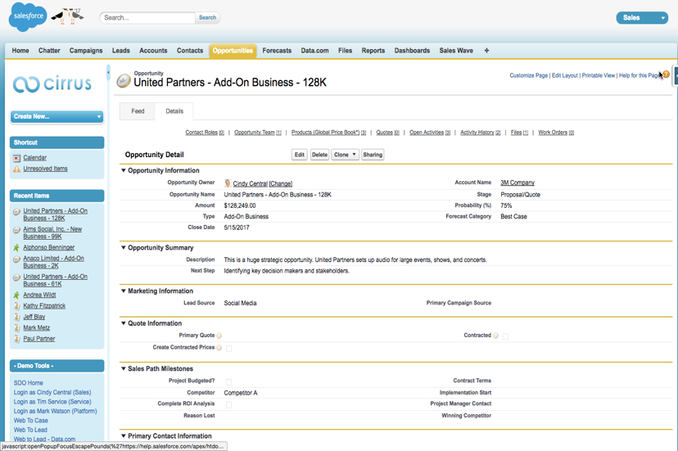
Lightning Experience
The UI for the way we want to use business apps
To
Workflow Productivity
From
Data Entry
Notes:
When Salesforce first came to market 18 years ago, it was revolutionary to have a single place everyone in your company could login to and track all of their customer interactions. And you could report on that seamlessly.
But expectations of how we want to consume information has changed. Today, instead of Salesforce being a thinly veiled database with a basic UI for capturing information, it’s a place that helps you get your work done every day. It’s about guidance and tools that accelerate your task completion. It’s your assistant and your task manager, as well as your place for managing all the information you need to about your customers.

Slide 10





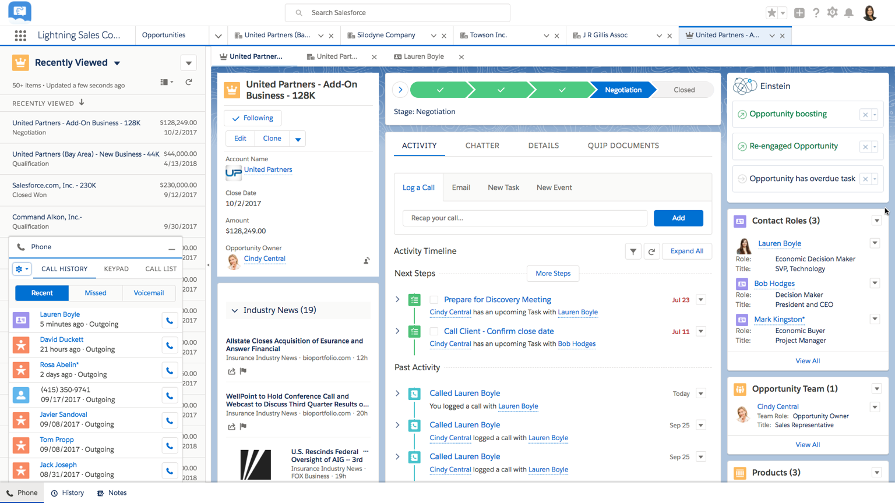
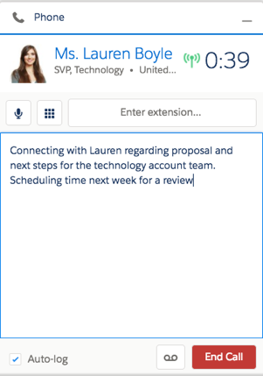
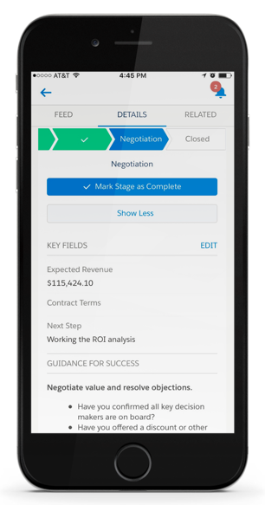
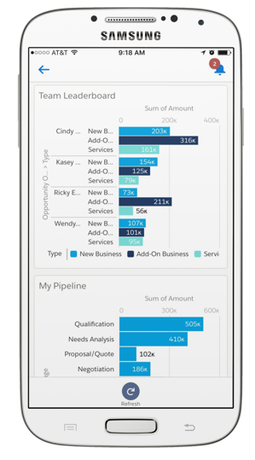


Lightning Experience: Making People Productive
Console
Split View
Navigate with nested tabs
Work lists in context
Actions
Follow up faster in context
Dialer
Activities
Make calls and drop voicemails
See latest actions
Dashboards
Utility Bar
Enhanced layouts and visuals
Customize actions to every page
Path
Guide next steps
Notes:
Lightning Experience was built to meet these changed expectations.
Salesforce re-envisioned how to help every user get things done and make them more efficient. When set up right, the new Salesforce helps sales and service users work more quickly and easily than ever.
Salesforce customers using Lightning Experience are seeing incredible adoption, because of powerful features that are available only in Lightning Experience:
Lightning Console accelerates tasks with a high productivity workspace.
Path allows you to define any repeatable process with best practices at every step.
Kanban & collaborative forecasting help you measure and manage your business and your entire team’s pipeline and processes better than ever.
These capabilities put more productivity at your fingertips and make you more productive at work.

Slide 11


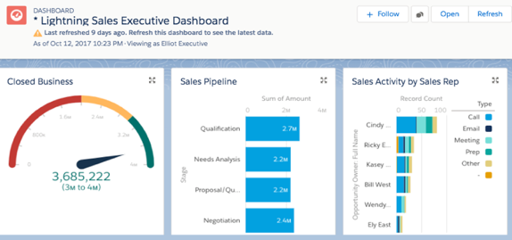

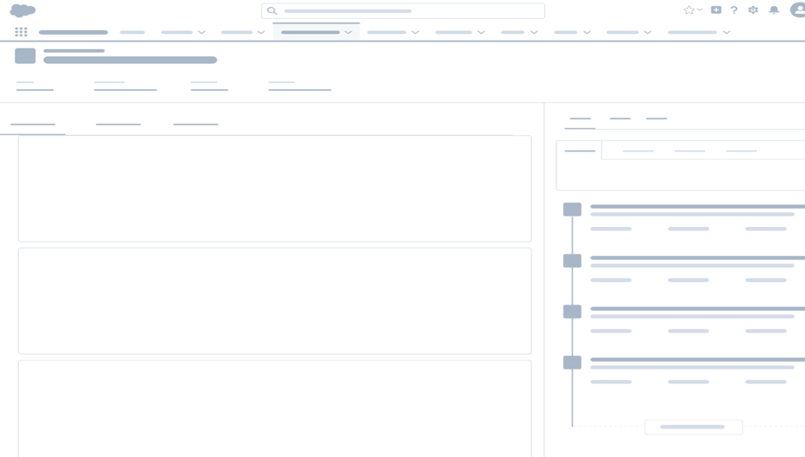

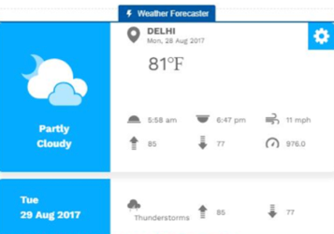

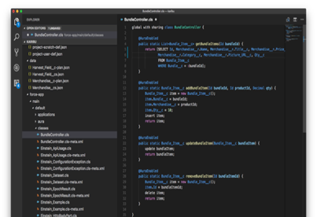
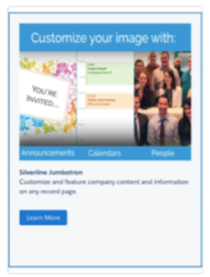
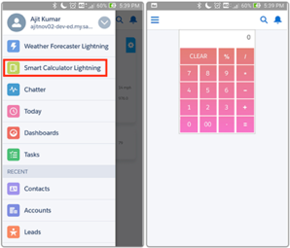
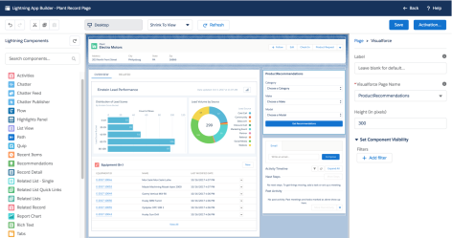
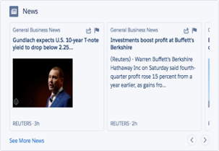
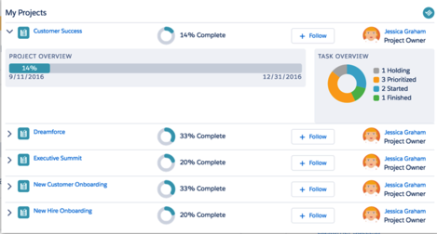

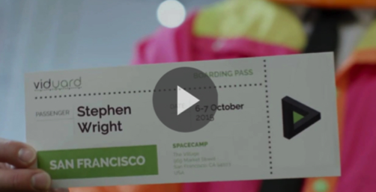
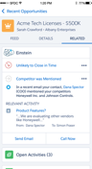
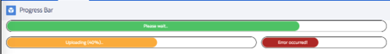
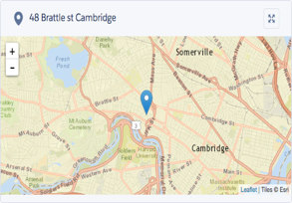

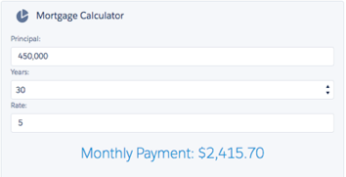
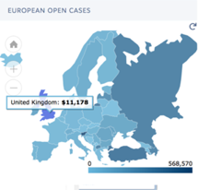
Lightning Platform: Empower Everyone to Build Apps
Business users and developers can prototype and build together
Build faster with customizable and reusable Lightning Components
Backed by a design system, tools, and an ecosystem
LOW-CODE
NO-CODE
CODE
BUSINESS USERS
DEVELOPERS
Notes:
The Lightning Platform helps you build apps fast.
No-code to code spectrum of products empowers everyone (from end users to developers) to be a part of the app dev process, decreasing the time to market for innovative ideas
The Lightning Platform has tools for you to succeed in building apps for your customers, partners, and employees
This is the key to rapid app development: your business users and developers work together, on the one platform, to solve business challenges
The Lightning Platform has no-code tools for declarative developers like Salesforce admins and business users and tools like Salesforce DX and Heroku for programmatic developers.
Lightning Components transform app development
Unlock the power of components and you’ll unlock the digital transformation inside your company
The currency of rapid app dev is Lightning Components – the building blocks of engaging apps build on Salesforce
Salesforce has a pre-built library of Lightning Components ready to use in your apps, and you can install pre-built components built by our partners from AppExchange
If you need more customization for your specific business needs, your developers can create reusable Lightning Components to order
All Lightning Components are supported by design principles and resources available in the Lightning Design System

Slide 12

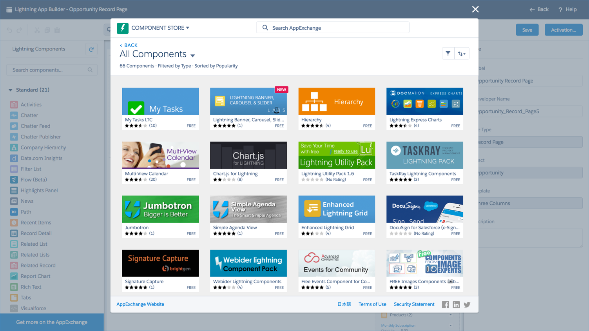
Lightning Ecosystem: Create Next-Level Experiences
The fastest path to business impact is with pre-built apps and components
^{Extend Any App}
^{70K+ Developers on Lightning}
^{1100+ Lightning Ready Apps}
^{100+ Lightning Components}
^{300+ Salesforce1 Ready Apps}
^{Customize Faster}
^{App Builder}
^{AppExchange}
Notes:
No faster way to deploy apps in your company to affect digital transformation than with a pre-built app from an industry leader
AppExchange is the world’s #1 enterprise app marketplace.
You can search and install pre-built apps and components from this rich partner ecosystem.
Because of the incredible re-usability of Lightning components, partners can re-package them and sell them or make them available for free for the Salesforce ecosystem. All of which is available right from the Lightning App Builder.
Why build apps from scratch, if industry leaders have already done the work

Slide 13






Lightning Delivers Value Across Every Team
Faster Time to Market
⁺ 50%
Improved Collaboration
⁺ 40%
The Total Economic Impact™ Of Salesforce Lightning, a June 2018 commissioned study conducted by Forrester Consulting on behalf of Salesforce.
Less Time Standardizing Process
Faster Reporting
Increased Productivity
Time Saved Developing
⁺ 29%
⁺ 28%
Improved Win Rates
⁺ 25%
⁺ 25%
Average Percentage Improvements Reported by Lightning Experience Users
⁺ 21%
Survey: 2017 Lightning Adoption Survey, N=500 Responses
End User Benefits
IT Benefits
Notes:
When working in Lightning Experience, users are seeing:
25% improvement in productivity
21% improvement in close rates
29% faster reporting
28% less time standardizing processes
and 40% increases in collaboration
And IT teams are seeing benefits too:
25% time saved developing
And 50% faster time to market

Slide 14
Lightning Experience
For Increased Productivity
Notes:
Demonstrate ten Lightning Experience features that increase productivity.

Slide 15



10 Lightning Experience Features for Salesforce Users
Out-of-the box features that help increase productivity
1
6
Calendar & Tasks
List Views
Console
Integrated Email
Lightning Record Pages
Chatter Feed
Navigation
Global Search
Reports
Dashboards
2
7
3
8
4
9
5
10
Notes:
These 10 features are out of the box with Lightning Experience, and require little to no customization.

Slide 16
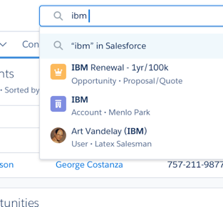
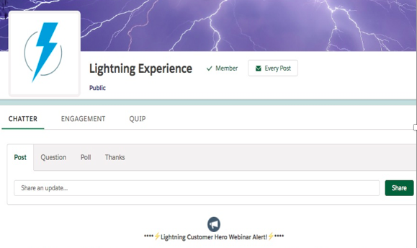
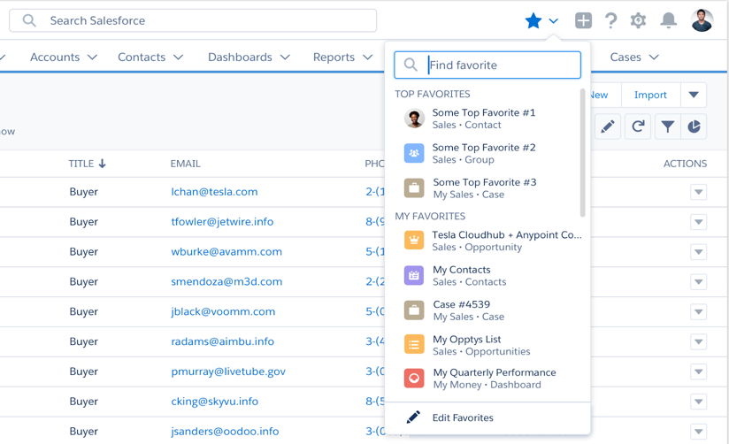
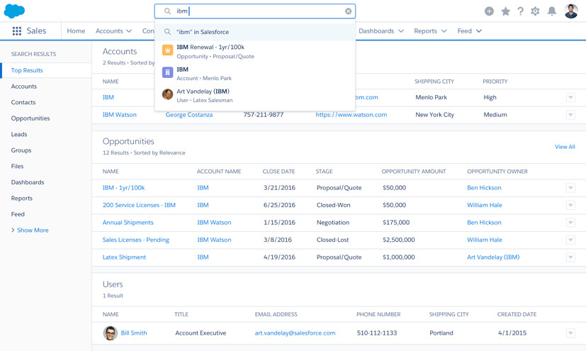

Share Information Easily and Find What You Need Faster
1
Chatter Feed
2
Navigation
3
Global Search
Collaborate with colleagues in real time. Work together, talk to each other, and share information.
Chatter streams
Recent groups
Share posts
Live feed typing indicators
Relevance ranked feed
Quickly access important records, lists, groups, dashboards, and more with personalized navigation and Favorites
Favorites: bookmark records, views, opportunities and more
Personalized Navigation: add the pages you need to the navigation bar
Reorder the navigation bar with drag-and-drop
Find things faster with enhanced Global Search
Instant type-ahead results
Top results across frequently-used records and objects
Scope search to get better results
Results ranked by relevance
Search for email
Notes:
Chatter Feed: Yes, Chatter exists in Salesforce Classic. But you can do way more in Chatter in Lightning Experience, including create personalized Chatter Streams that allow individual users to develop curated lists of content that is most relevant to them and see all Chatter posts related to that content.
Navigation: Bookmark and easily return to favorite content in Lightning Experience using Favorites - the little star in the top right hand corner! Or, users can add their own tabs to the navigation bar. Tabs can include objects, records, list views, reports, dashboards, and more.
Global Search: Users can find the things they need, more easily and quickly, with improved global search.
Instant Results suggest records across frequently accessed objects with names that match search terms.
Top Results display the most relevant records for frequently accessed objects. All searches go to Top Results.
Scope search results to specific objects with the search results pane on the left side of the page.
Results are ranked by relevance so the best results are displayed at the top.

Slide 17
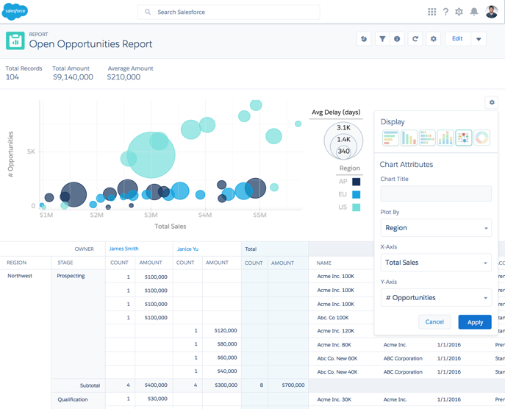
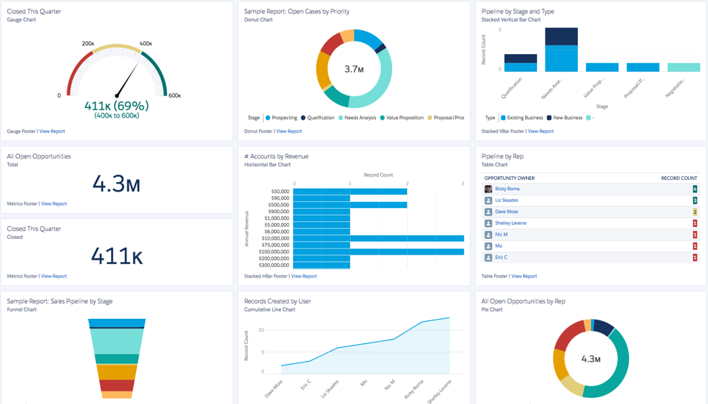
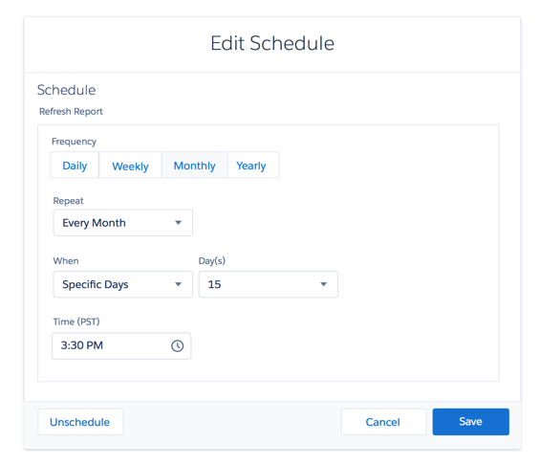


Visualize Data with New Reports and Dashboards
4
Reports
5
Dashboards
Visually display key metrics and trends for records in your org
Drill to report from filtered dashboard
Tacked combo charts, pictures on table charts, conditional highlighting, improved table component
Denser charts, smaller metrics
Post on charts and follow dashboards
Edit running user, folder
Subscribe to dashboards
Create reports that meet the criteria you define and filter, group or display in a graphical chart
Lightning Report Builder
Subfolders for Report and Dashboard folders
Role hierarchy filter on reports
Relative Date filters
Enhanced charts in the Salesforce mobile app
Dynamic filter URL
Export formatted report
Subscribe to reports
Notes:
Reports:
Many business processes involve exporting Salesforce reports for further analysis in a 3rd party tool. Lightning Experience supports this important capability.
For reports that are used by multiple people, collaboration on the report is key. With the Chatter feed enabled for reports in Lightning Experience, users can share and discuss reports directly on the Reports page.
And, if needed, they can easily export all of those reports.
Dashboards: With dashboards in Lightning Experience, users can easily make Dashboard components as tall or as wide as needed with drag-and-drop functionality. And users can collaborate on the dashboards themselves.

Slide 18
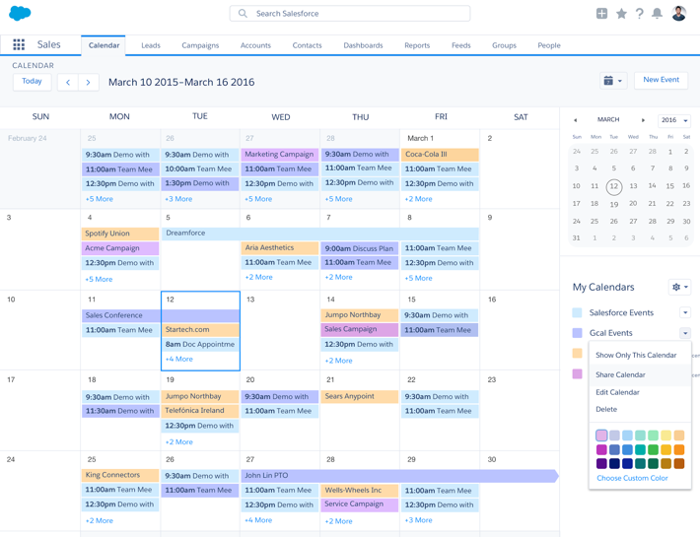
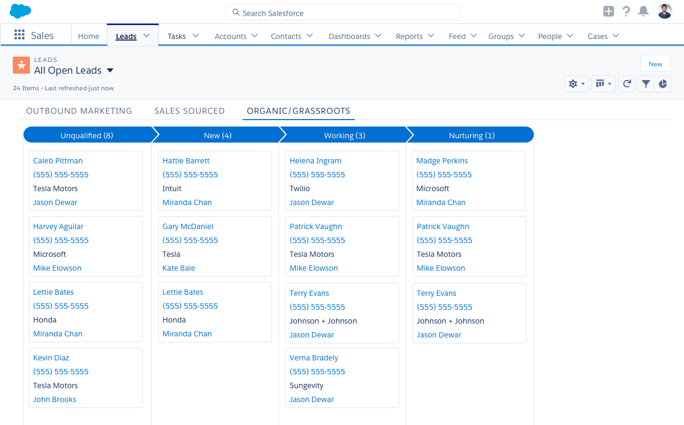
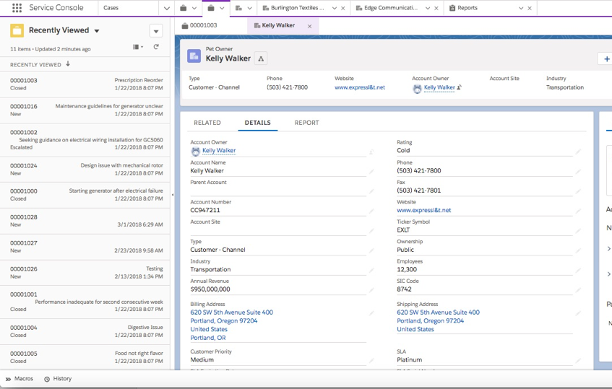


Visualize Data at a Glance and Make Edits Quickly
6
Calendar & Tasks
7
8
List Views
Console
Integrate calendaring into everything
View Google calendar events
Create calendars for custom & standard objects
Drag and drop calendar items
Create custom list views for Tasks
Set recurring and follow up tasks
Tasks and events in search
Edit your record information quickly and easily on the page
Quickly modify records on a single page
Wrap text within text fields
Create List View charts
View as Kanban on any object with configurable settings for ‘group by’ and ‘summarize by’ fields
Drive productivity while working in Salesforce
Use pre-built sales and service consoles
Eliminate need for multiple browser tabs
Open related records as sub-tabs
Pin Tabs
View records in Split View
Apply macros
Notes:
Calendar & Tasks: We all use calendars all the time. They’re a critical part of productivity for all sales reps and for anyone in any business. The calendar in Lightning Experience lets you see all of your Salesforce events in a calendar view. And you can create new appointments in your calendar which automatically show up as Events in Salesforce. Additionally, you can create a calendar view to display any records with a date field.
List Views:
Quickly modify multiple records from the same page, or make the same change to multiple records at once.
Kanban view allows users to see their data in a whole new way. Instead of seeing data as a list, view it organized by a picklist of your choosing. For example, see Opportunities organized by stage or view Accounts by type. The possibilities are endless. Kanban has received a lot of positive feedback from customers. This view is available for all standard objects and custom objects.
Console: Work more productively in Lightning Experience using a Console. All of a user’s records open as tabs along the top, and related records open as sub-tabs under that. The console environment helps to keep work organized and eliminates the need to juggle multiple records across browser tabs.

Slide 19
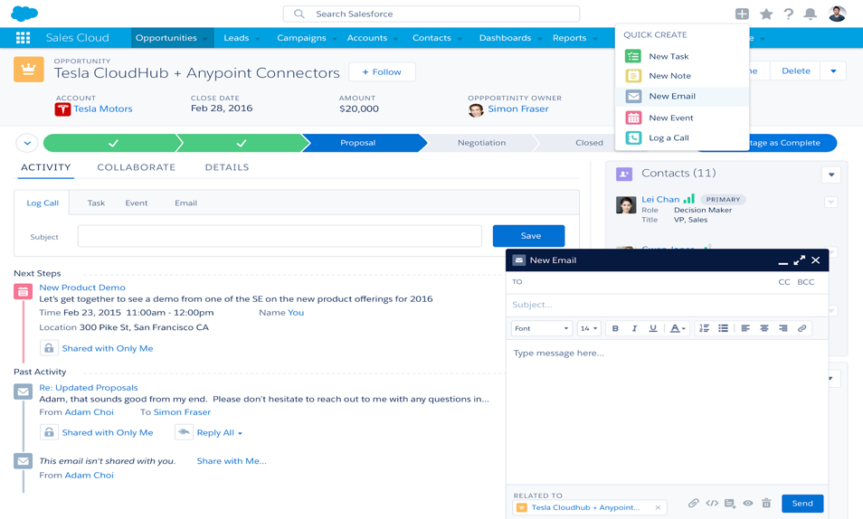
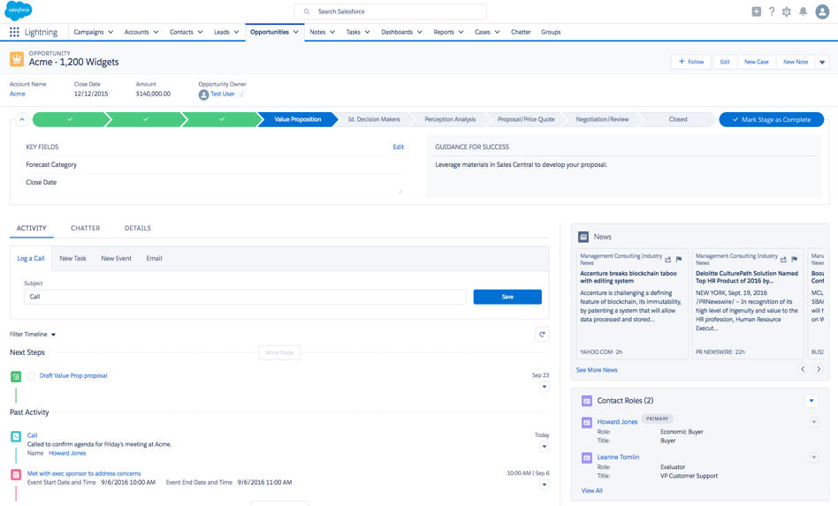
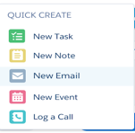


Increase User Productivity to Close Deals Faster
9
Integrated Email
10
Lightning Record Page
Create, view and respond to email within Salesforce
Create email from anywhere within Lightning Experience
Use org-wide addresses
Send through Gmail or Office365
Enhanced email experience for Person Accounts
Drag and drop email attachments
Find data faster and make it more actionable
Path
Highlights panel
Activity timeline
Related lists
Related records
Report charts
News
Notes:
Integrated Email: In Lightning Experience, email is better integrated into the sales process. Send emails through Gmail or Office365. Get richer email support directly in Salesforce with a new email interface and the Enhanced Email object. Reply to and forward emails from Lightning Experience.
Record Pages: Record pages in Lightning Experience make it easier to find your data and take the needed actions. With the Opportunity workspace, help close deals faster and serve customers better by using tools like Path.

Slide 20
DEMO 1:
Lightning Experience Productivity Features
bit.ly/LIAB18demos
Notes:
Although you can show the following video, we recommend that you always do a live demo for maximum impact! We’ve made it easy for you to learn how to demo by providing both the click paths and a sample talk track – you can access everything you need here: bit.ly/LightningBoxDemos

Slide 21
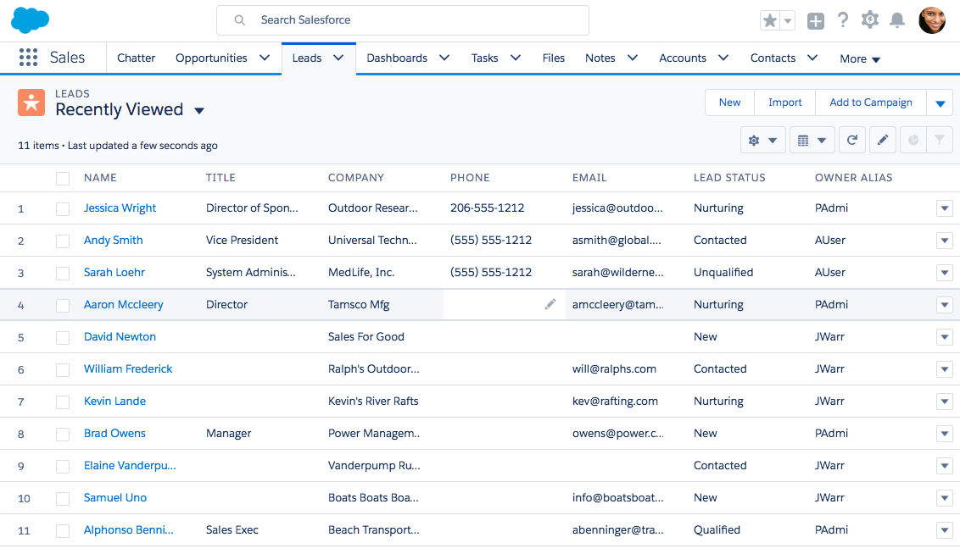


Demo Video: 10 Lightning Experience Features to Increase Productivity
Click here for the Demo Click Path
Notes:
Demo Click Paths:
http://bit.ly/lightningboxdemos
Demo Video:
https://youtu.be/yg7fcsbjUTg

Slide 22
Customize Lightning Experience
Notes:
Show your stakeholders what you, as an #AwesomeAdmin, can do to make Lightning Experience the perfect fit for your company.

Slide 23


5 Ways to Customize Lightning Experience
Build, customize, and deploy apps faster than ever, no code required
1
Build Custom Home Pages
Build Lightning Apps
Customize Path for Users
Customize and Assign Record Pages
Personalize with Custom Themes and Branding
2
3
4
5
ASTRO’S QUICK TIP:
Customizing with clicks reduces the need for code and makes it easier to maintain your customizations. It also means you’ll benefit from release updates.
Notes:
Admins can build apps even faster. Lightning Experience has an entire suite of drag-and-drop tools to make app building a breeze.
Build apps faster than ever with Lightning App Builder. Assemble apps and customize pages for any device with drag and drop. You can also create a premier, customized community or easily automate complex business processes with point-and-click tools.
Easy to iterate. Easily make changes to a page with drag-and-drop. Get feedback and immediately iterate.
The Lightning Platform empowers everyone to build apps, with declarative tools and programmatic options.
Developers and partners build components, admins assemble those components into pages, creating a new model of collaboration

Slide 24

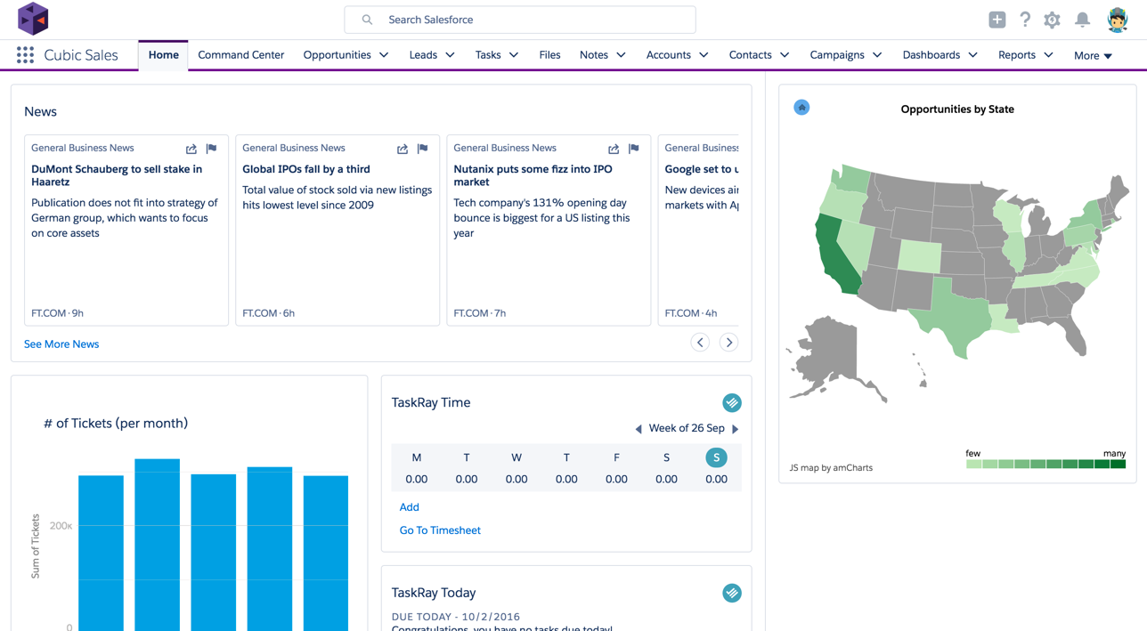
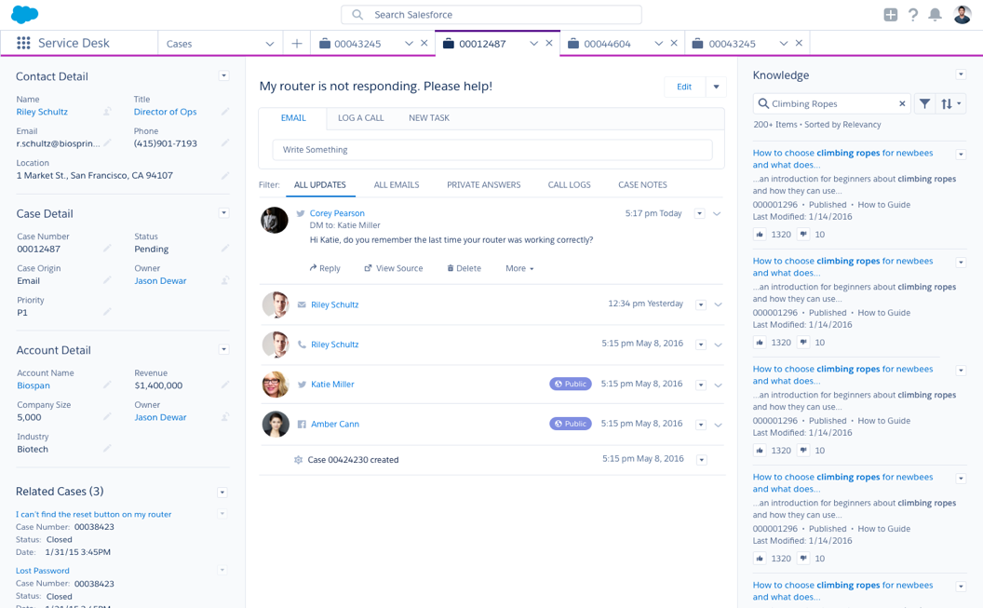
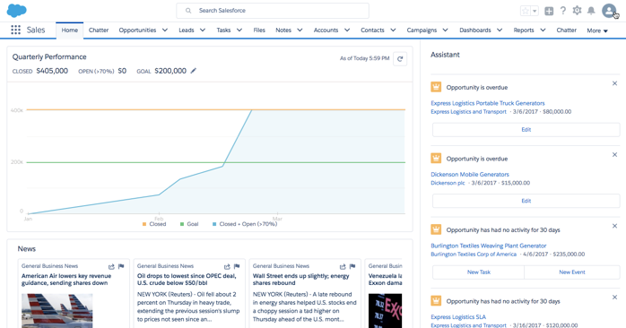
Customize Pages and Build Apps More Easily
1
Build Custom Home Pages
2
Build Lightning Apps
Give users the ability to access the information they need to get their jobs done faster
Custom branding
Utility bar
Customizable navigation rules
Service setup
Build and manage apps with Lightning App Builder
Create a welcoming experience for all of your users
Create multiple home pages and assign to different profiles
Build an org-wide default page or build individual pages that can be assigned to one or more profiles for role-specific content
Control component visibility with Dynamic Pages
Notes:
Build custom home pages: Sales users are interested in different things than Marketing users. You can develop different home pages so different users get more relevant information when they log in.
Build Lightning apps: Create experiences that are tightly tailored to the needs of a team or group of users. Create Lightning console apps to give users a workspace for editing and referencing multiple records at once.

Slide 25
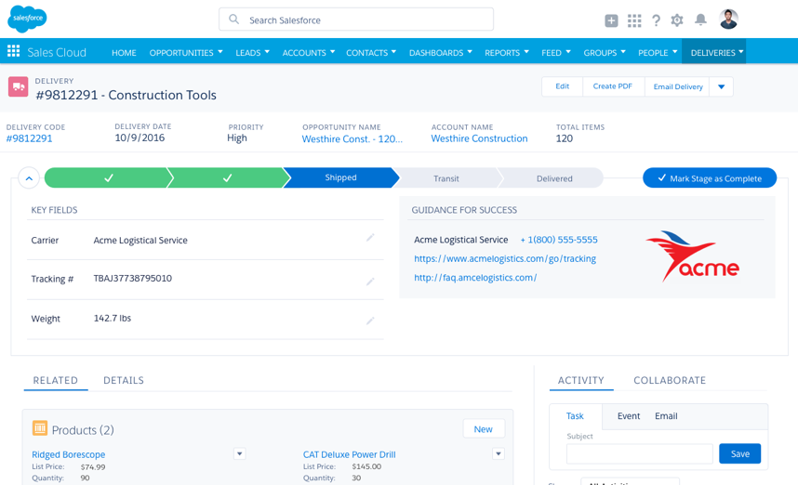
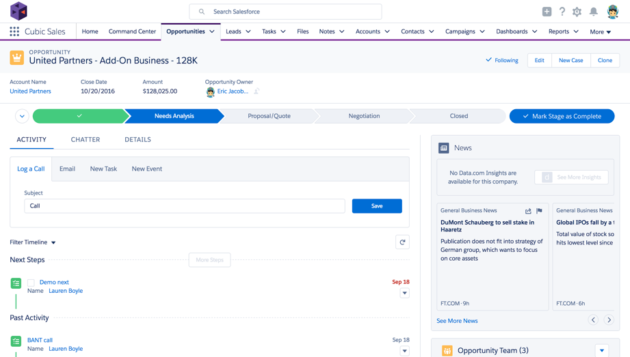

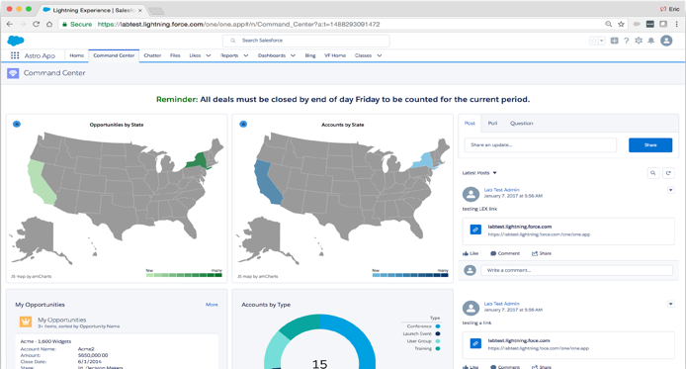




Design a Relevant and Modern User Experience
3
Customize Path for Users
4
Customize and Assign Record Pages
5
Personalize with Custom Themes and Branding
Guide users through each stage of a process
Path on most standard and all custom objects
Designate the standard or custom field that drives the “path”
Provide users with guidance for success
Customize the detail pages for standard and custom objects
Existing metadata powers the experience
Page layouts control fields, related lists, and actions
Compact Layouts control the field in the Highlights Panel
Assign page for org, app, profile, or record type
Control component visibility with Dynamic Pages
Apply your own branding & custom themes
Brand colors throughout the app
Custom background
Custom Chatter header
Custom user profile header
Notes:
Path on most objects: Guide your reps through each stage of a process and give reps the guidance they need to close deals.
Customize and assign record pages for custom & standard objects: Customize the detail pages for standard and custom objects.
Custom themes and branding: Make apps your own

Slide 26
DEMO 2:
Lightning Experience Customization Options
bit.ly/LIAB18demos
Notes:
Although you can show the following video, we recommend that you always do a live demo for maximum impact! We’ve made it easy for you to learn how to demo by providing both the click paths and a sample talk track – you can access everything you need here: http://bit.ly/LIAB18demos

Slide 27

Demo Video: 5 Ways to Customize Lightning Experience
Click here for the Demo Click Path
Notes:
Demo Click Paths:
http://bit.ly/lightningboxdemos
Demo Video:
https://youtu.be/2TV042eAPzk

Slide 28
Strategies for Transitioning to Lightning Experience

Slide 29
Pick a Rollout Strategy That Works for Your Company
Start with a Pilot
New Users
Move Existing Users in Phases
OR
All Users
Use Permission Sets or Custom Profiles to get feedback on Lightning Experience from a small pilot group of users
Start new users in Lightning Experience from the get-go
Move existing users in phases, as Lightning Experience use cases meet their needs
Move your entire user population
to Lightning Experience at the same time

Slide 30


Lightning Experience Users Can Access Salesforce Classic
Both experiences are available for customers to use, at the org level, profile level, or user level
Lightning Experience | Salesforce Classic
The user experience predating Lightning Experience is Salesforce Classic.
If users need a few features that you haven’t implemented in Lightning Experience yet, they can quickly switch back to Salesforce Classic to keep working.

Slide 31
Resources
Notes:
Use this time to check if anyone has any questions, comments, suggestions or ideas.

Slide 32


Resources
Lightning Experience Readiness Check
in Setup
Prepare with Trailhead
More Resources for Admins
Lightning Now! Group
Evaluate your org’s readiness for Lightning Experience
Determine which users are ready to work in the new interface
Develop your rollout plan
Make the Move to Lightning Experience
Learn to Work with Lightning Experience
Lightning Experience Video Series
Learn Lightning Blog Series
Lightning Experience Pro Tips Series
Release Notes
success.salesforce.com
Notes:
Let your audience know that there is lots of information and plenty of resources available to help them learn how to use Lightning Experience.
Ask if anyone has any questions, and proceed to discuss any questions or concerns they may have

